Slide 1

MusicXML
Intro to XML
Natalie Aldrich
Notes:
MusicXML
Natalie Aldrich
3/24/16
Intro to XML
Prof. Dan Sciuto

Slide 2
What is MusicXML?
An open source XML-based language used to reference western music.
Primarily used to share electronic sheet music.
Serves as a common language to transfer between many different music software programs.
Notes:
MusicXML is an open source XML-based language used to reference western music. One of its main roles is sharing electronic sheet music. It can represent complex structured data, which is necessary when it comes to the intricacies of musical scores.

Slide 3
Use in the Music Industry
Music Software Companies
MakeMusic (Finale, Songwriter, PrintMusic)
Sibelius (Sibelius Student, Sibelius First)
Steinberg (Cubase, Nuendo)
iOS notation programs (Symphony Pro, PocketScore, SeeScore)
Electronic Music Stands (Organ Muse)
Sheet Music Sales Systems (Legato Sheet Music Viewer)
Online Music Libraries (IMSLP, MuseScore)
Musicology
Apps (MelodicMatch, music21)
Notes:
MusicXML is, naturally, utilized within the music industry. Academics, such as musicologists, require access to many scores with as much ease as possible. Music software developers also make heavy use of MusicXML, which proves especially useful in composition and music production software .

Slide 4
Predecessors to MusicXML
MIDI (Musical Instrumental Digital Interface)
NIFF (Notation Interchange File Format)
SMDL (Standard Music Description Language)
Notes:
Before MusicXML, it was difficult to share music electronically. For example, suppose there are 100 music documents, each with their own format. To communicate notation between these document types, 10,000 programs would need to be written. With a common notation language, only 100 programs would need to be written.

Slide 5

MIDI: Pros and Cons
Good as a performance language.
Poor at notation (ex. Gb vs F#)
I found your old blog! Neat song!
Notes:
The only commonly supported music notation interchange format was MIDI. You may remember MIDI as the sound format that brought you those lovely synthesized versions of pop songs that used to auto-play if you visited a friend’s super cool page on Geocities. MIDI was serviceable for just that, performance applications, but it was weak when it came to actual music notation.
For example, MIDI was unable to tell the difference between a Gb and a F#. While those two notes are physically one and the same on a musical instrument (“enharmonic”), the context of the two notes are radically different and may even affect the tuning of a musical instrument when put into use. Apart from MIDI, there were two other predecessors to MusicXML: NIFF and SMDL.

Slide 6
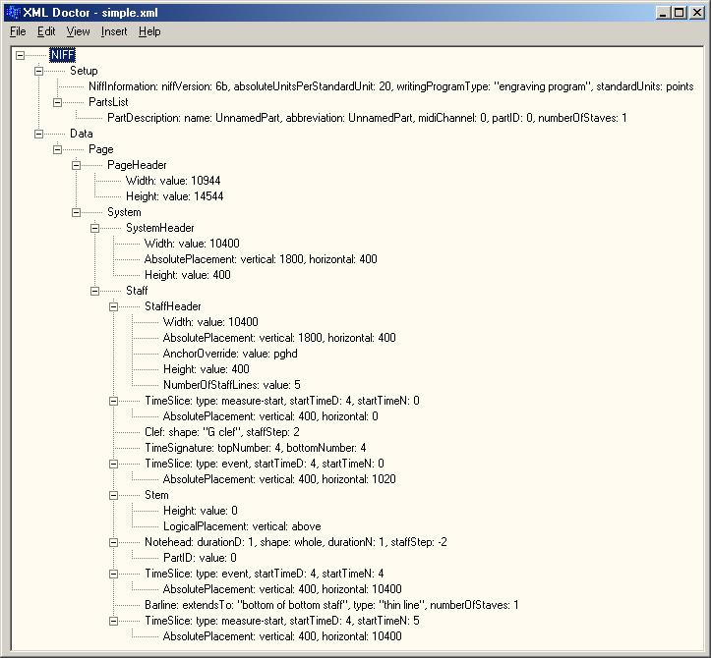
NIFF
Graphic representation of music
Used with scanning programs
Better at notation than MIDI
No inherent concept of pitch
No sequencing with musical database
NIFF example
Notes:
NIFF’s focus was graphical music representation. It had no inherent concept of, for example, the musical note “C”, but could place it on a picture of a staff. It worked well with scanning programs, but not at sequencing to a musical database, and at the end of the day, MIDI was still better than NIFF at both, though it still had an edge on graphical notation.
Picture from http://niffty.sourceforge.net/xml/

Slide 7
SMDL
Goal was to depict every possible style of music.
Too complicated for mass use.
No commercial support.
Enter MusicXML
Notes:
SMDL was an ambitious venture that sought to represent every style of music that ever existed and ever could be created. It ended up being too complicated for the majority of people to understand, so was never given commercial software support.

Slide 8

Basis for MusicXML
Muse Data format
Walter Hewlett, Center for Computer Assisted Research in the Humanities at Stanford Univserity
Humdrum format
David Huron, Ohio State University
Example: http://museinfo.sapp.org/doc/examples/humdrum/chord/chord.html
XML
MusicXML can recreate even Kanye’s sick beats!
Notes:
Enter MusicXML. MusicXML’s design comes from the Muse Data format, developed by Walter Hewlett (who is, in fact, tangentially related to the HP company) at the Center for Computer Assisted Research in the Humanities at Stanford University, and the Humdrum developed by David Huron at Ohio State University. The first beta version of MusicXML was essentially an XML (based on SGML and HTML) update of MuseData with some Humdrum components thrown in. There was a key difference in desired application, though. Both of the aforementioned formats dealt primarily with classical and folk music. MusicXML was intended for the pop contemporary genre.
Picture from http://www.king-biscuit.com/wp-content/uploads/2016/02/Kanye-West-3.jpg

Slide 9
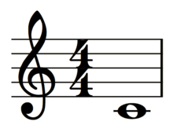
<?xml version="1.0" encoding="UTF-8" standalone="no"?>
<!DOCTYPE score-partwise PUBLIC
"-//Recordare//DTD MusicXML 3.0 Partwise//EN"
"http://www.musicxml.org/dtds/partwise.dtd">
<score-partwise version="3.0">
<part-list>
<score-part id="P1">
<part-name>Music</part-name>
</score-part>
</part-list>
<part id="P1">
<measure number="1">
<attributes>
<divisions>1</divisions>
<key>
<fifths>0</fifths>
</key>
<time>
<beats>4</beats>
<beat-type>4</beat-type>
</time>
<clef>
<sign>G</sign>
<line>2</line>
</clef>
</attributes>
<note>
<pitch>
<step>C</step>
<octave>4</octave>
</pitch>
<duration>4</duration>
<type>whole</type>
</note>
</measure>
</part>
</score-partwise>
Example and Result
Treble clef, 4/4 time signature, C major, with a whole note on middle C.
*One page of music amounts to thousands of lines of code.
Notes:
Code from musicxml.com

Slide 10
Representing Sheet Music
Prolog points to vocabulary.
<score-partwise> is root musical element
<part-list>, <measure>, <attributes>, <clef>, <time>, <key> and more to be identified before first note is even mentioned.
Notes are referred to with the <note> element and contain elements that refer to <pitch> and <duration>.
<pitch> contains <step> and <octave> to specify the note.
<duration> contains a numeric value that refers to how many beats the note goes on for.
Notes:
MusicXML is used to express sheet music. In action, it’s language that values nesting elements over assigning attributes (even going as far as using an element called <attributes> to describe the set up for a score. Case in point: (Wikipedia example) is everything required to set up just a treble clef, a time signature, and one note. However, MusicXML uses language familiar to the music industry, so as wordy as the process is, the translation from music to text isn’t incomprehensible.
For example, after the prolog, which links to the MusicXML vocabulary, we come across the root element <score-partwise> followed by a version number, followed by the <part-list> element. This contains a list of the different instrumental or vocal parts in a piece. The parts are assigned an ID via the id attribute and named.
Now the actual music begins to happen. Inside a part, marked with an ID attribute that corresponds to the one assigned to it in the <score-part> element. From here, the information for the music is nested in <measure> elements, with a number attribute marking the measure’s order. Inside the measure is an <attributes> element, containing a <key> element. Nested in the <key> element is <fifths>, which holds a numeric value that relates to the position of a key in the Circle of Fifths . <time> is reserved for defining the time signature, and <clef> designates the desired clef and its position. Once the attributes are established, we get to the <note> element, which covers pitch (the name of the note and which octave its in) and duration (what kind of note and the length it’s held). To add to the basic elements for basic note display, there are also many elements related to the format of the page, the appearance of the staff, the appearance of the notes, how lyrics are placed, and metadata.

Slide 11
The Future of MusicXML
Development switched from MakeMusic to the W3C on July 28, 2015.
First meeting of W3C Music Notation Community Group in Europe (W3CMNCG?) on April 8, 2016.
Work on MusicXML 3.1 started in the beginning of 2016.
Notes:
For the past three years, a MusicXML community meeting has been taking place at the Musikmesse fair in Frankfurt, Germay.
As of July 28, 2015, the development of MusicXML has changed hands from MakeMusic to the W3C. April 8th will mark the first meeting of the W3C Music Notation Community Group in Europe (W3CMNCG?). One of the main focuses of the meeting will be on MusicXML 3.1 , which began development at the start of 2016.

Slide 12
Goals for MusicXML ♫
Short Term
Add support for SMuFL (Standard Music Font Layout) glyphs
Identify remaining gaps in SMuFL use
Long Term
DOM manipulation
Make a complete specification doc

Slide 13
Conclusion
MusicXML is the go to notation sharing language of the music industry
Solves the long standing problem of sharing music effectively between software programs and online
Verbose but effective
Still actively being worked on and honed today
Notes:
MusicXML has overtaken the music industry as the way to efficiently share music notation electronically. Though verbose, it is easy to understand and is widely supported by major music software programs, musicology apps, and electronic music sellers.

Slide 14
Bibliography
"MusicXML FAQ." MusicXML. MakeMusic Inc., n.d. Web. 15 Mar. 2016. <http://www.musicxml.com/tutorial/faq>.
"Latest News - MusicXML." MusicXML. MakeMusic Inc., n.d. Web. 18 Mar. 2016. <http://www.musicxml.com/latest-news/>.
"Music in MusicXML - MusicXML." MusicXML. MakeMusic Inc., n.d. Web. 24 Mar. 2016. <http://www.musicxml.com/music-in-musicxml/>.
Code Source: "Hello World: A One-Bar Song with a Whole Note on Middle C in 4/4 Time." MusicXML. MakeMusic Inc., n.d. Web. 24 Mar. 2016. <http://www.musicxml.com/tutorial/hello-world/>.

